Slide 1
Winners of the 2024 Platform Quran Competition

Slide 2
2024 Platform Quran Competition HIFZ GROUP 1 Winners

Slide 3
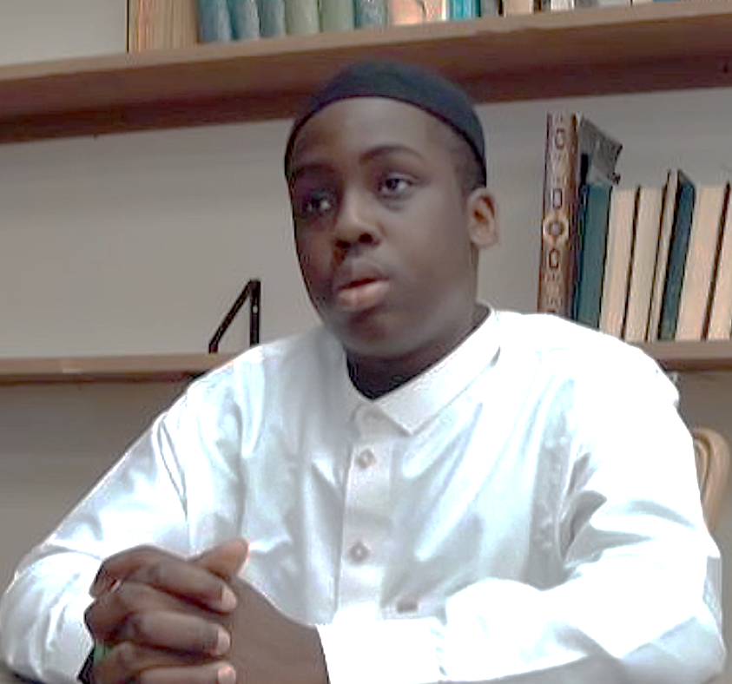
3rd Place
Rayhaan Manayajo
Muslim Community Center of Rhode Island
Winning Prize: $300

Slide 4
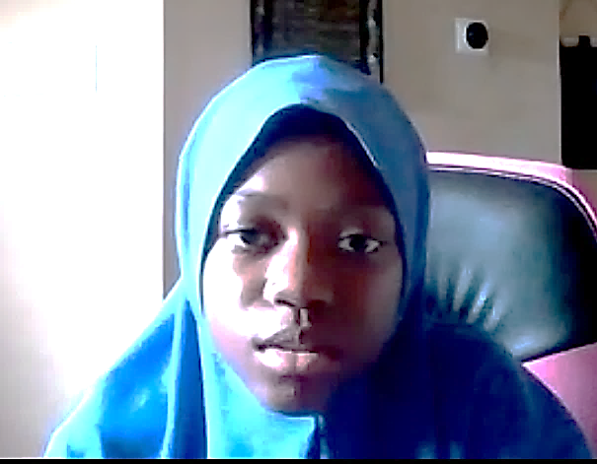
2nd Place
Abrar Masud
Masjidul-Mumineen of Greater Houston
Winning Prize: $350

Slide 5
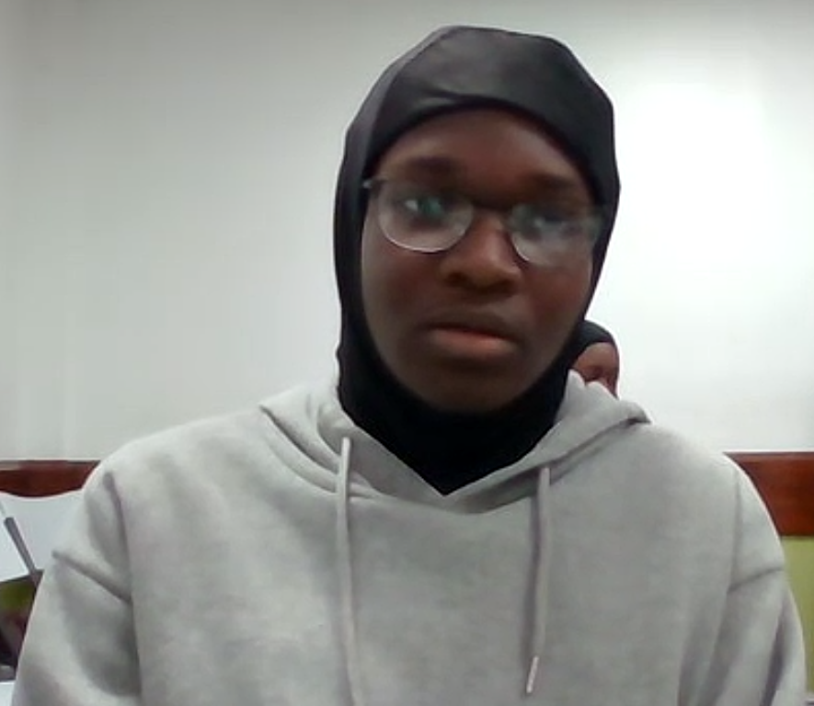
1st Place
Hanatullah Salawudeen
Nigeria Islamic Association of Chicago
Winning Prize: $400

Slide 6
2024 Platform Quran Competition QIRAA GROUP 1 WINNERS

Slide 7
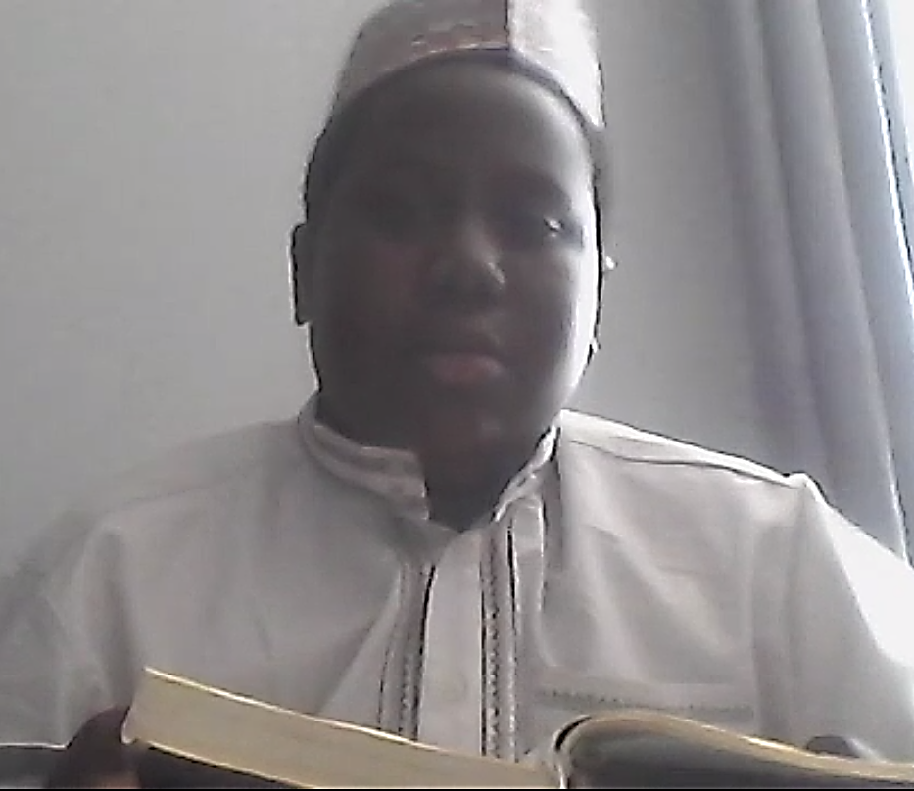
3rd Place
Ammar Oritola
Nigeria Muslims Association of Dallas
Winning Prize: $200

Slide 8
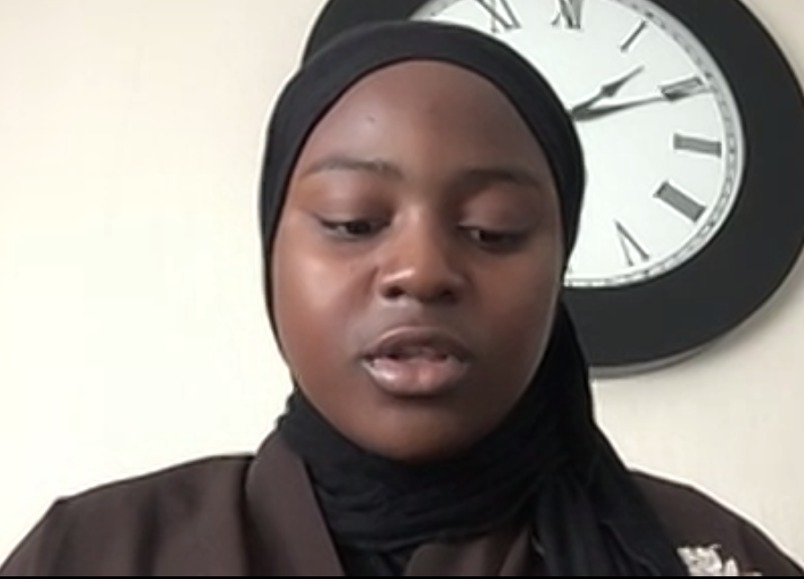
2nd Place
Rihanat Lawal
Light of Islam Chicago
Winning Prize: $250

Slide 9
1st Place
Hanan Adediran
Masjidul-Mumineen of Greater Houston
Winning Prize: $300

Slide 10
2024 Platform Quran Competition HIFZ GROUP 2 WINNERS

Slide 11
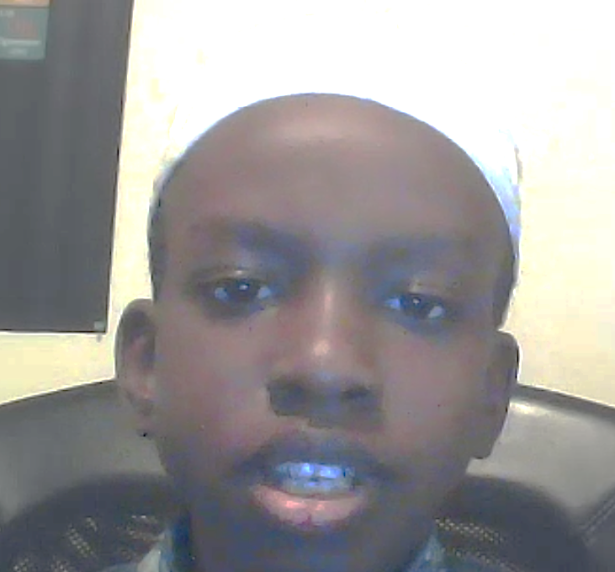
3rd Place
Harun Bidmus
Masjidul-Mumineen of Greater Houston
Winning Prize: $350

Slide 12
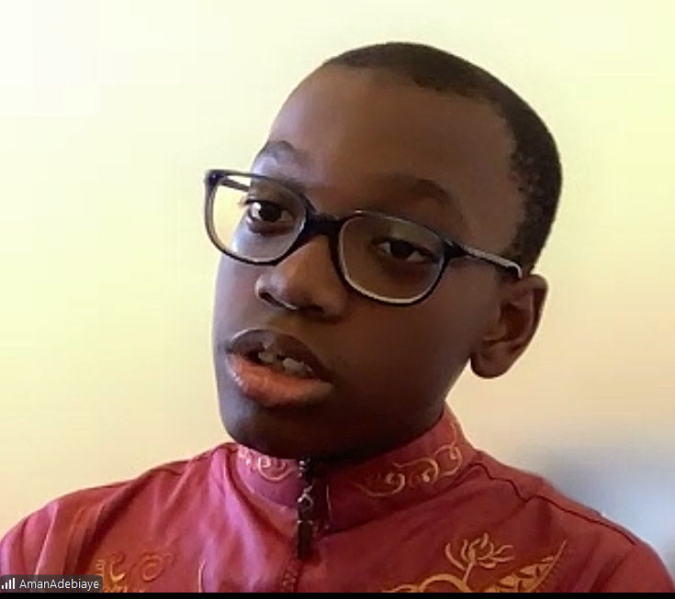
2nd Place
Aman Adebiaye
Nigeria American Islamic Mission, Newark NJ
Winning Prize: $400

Slide 13
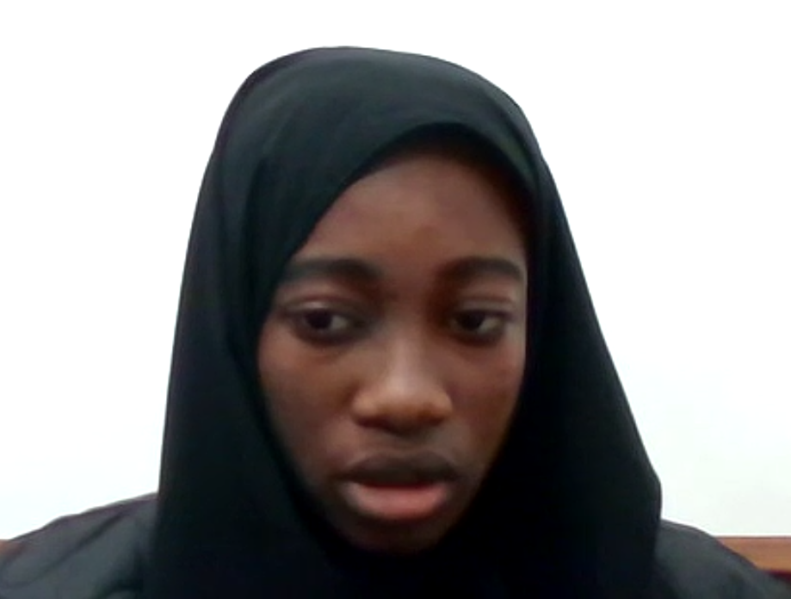
1st Place
Mariam Lawal
Nigeria Islamic Association of Chicago
Winning Prize: $450

Slide 14
2024 Platform Quran Competition QIRAA GROUP 2 WINNERS

Slide 15
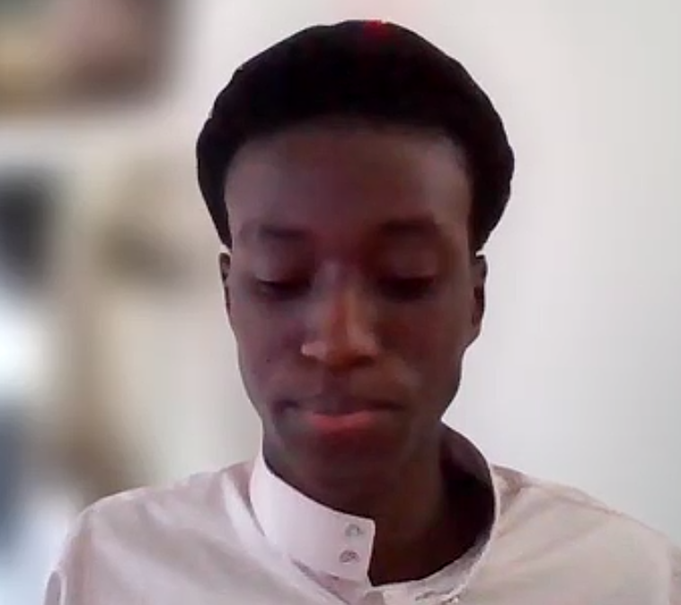
3rd Place
Farhan Badaru
Nigerian Muslims Association of Dallas
Winning Prize: $250

Slide 16
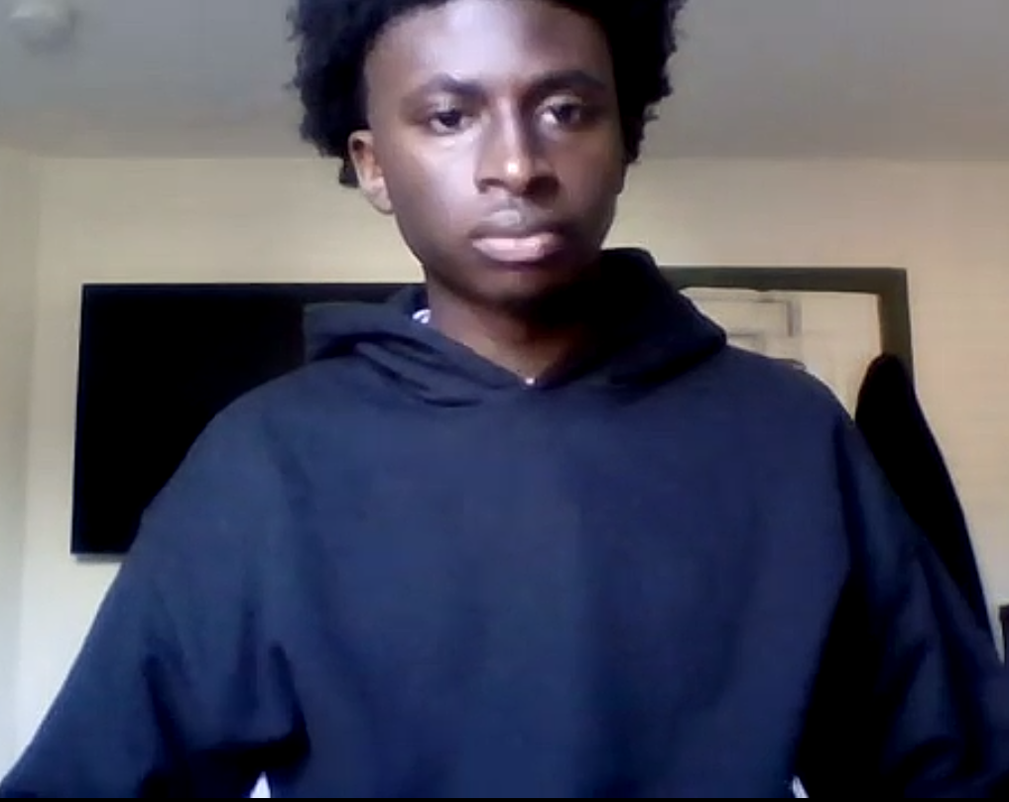
2nd Place
Marzooq Mayaleeke
Muslim Community Center of Rhode Island
Winning Prize: $300

Slide 17
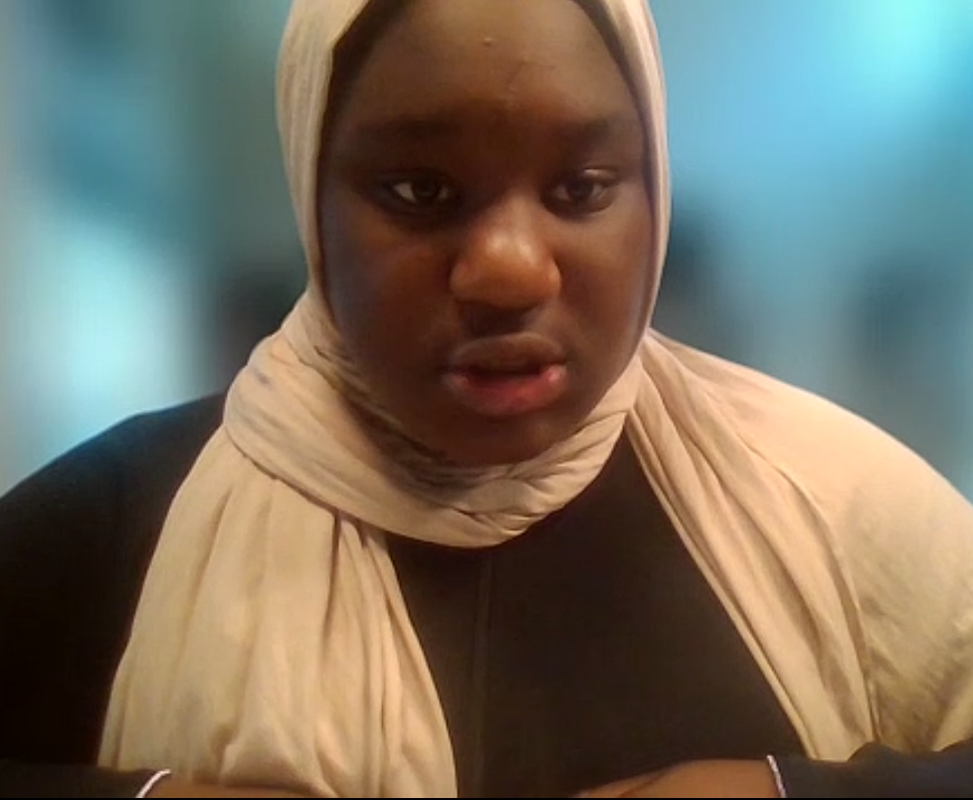
1st Place
Aisha Olaoye
Masjidul-Mumineen of Greater Houston
Winning Prize: $350

Slide 18
2024 Platform Quran Competition HIFZ GROUP 3 WINNERS

Slide 19
3rd Place
Muhammad Akinola
Istijaba Muslim Association of Southern NJ
Winning Prize: $400

Slide 20
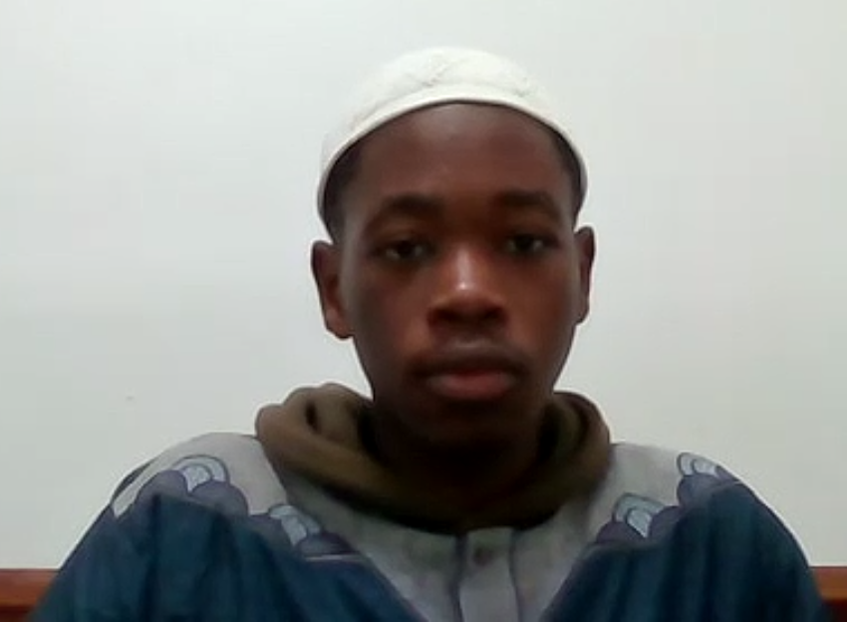
2nd Place
Abdul-Hameed Mohammed
Nigeria Islamic Association of Chicago
Winning Prize: $450

Slide 21
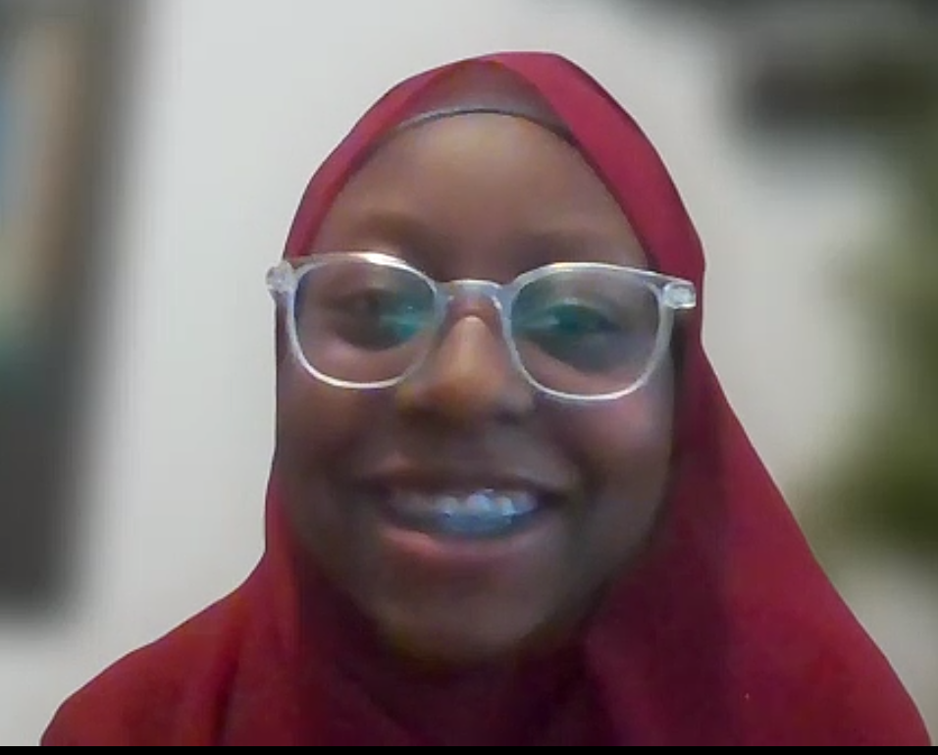
1st Place
Hazeerah Bidmus
Masjidul-Mumineen of Greater Houston
Winning Prize: $500

Slide 22
2024 Platform Quran Competition QIRAA GROUP 3 WINNERS

Slide 23
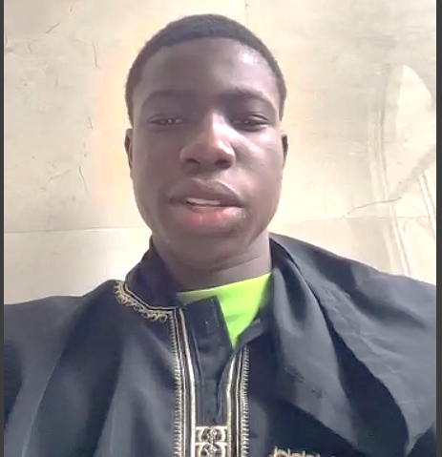
3rd Place
Abdusobur Alimi
Masjidul-Mumineen of Greater Houston
Winning Prize: $300

Slide 24
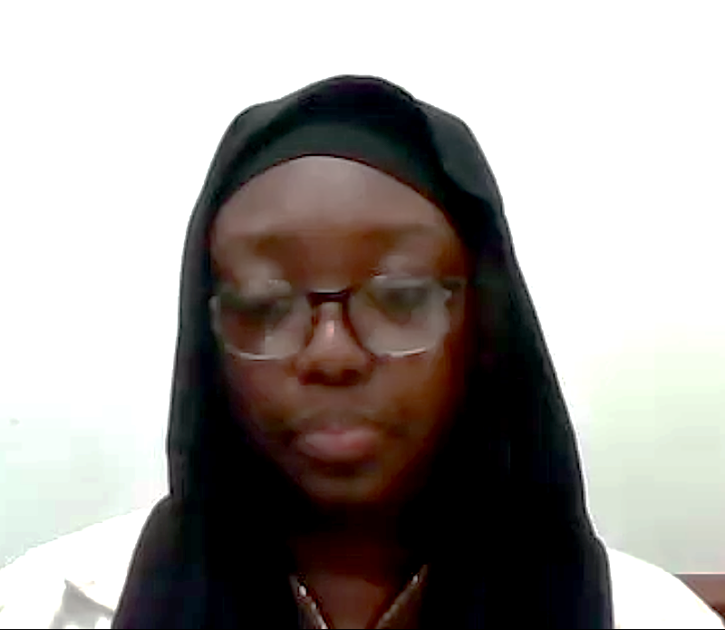
2nd Place
Taekiya Jaji
Nigeria Islamic Association of Chicago
Winning Prize: $350

Slide 25
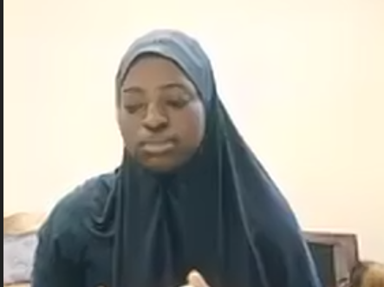
1st Place
Rahmatallah Uthman Afolarin
Istijaba Muslim Association of Southern NJ
Winning Prize: $400

Slide 26
2024 Platform Quran Competition HUFFAZ GROUP WINNERS

Slide 27
3rd Place
Abdul-Baasit Oritola
Nigerian Muslims Association of Dallas
Winning Prize: $650

Slide 28
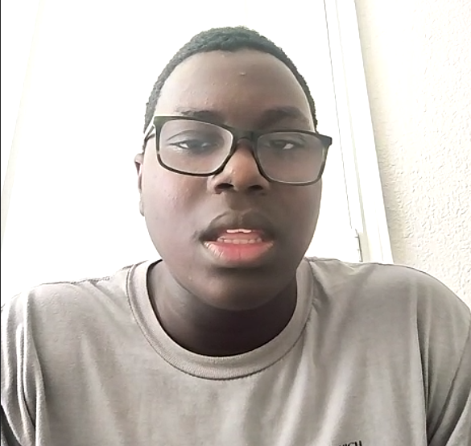
2nd Place
Abdul Rahman Oritola
Nigerian Muslims Association of Dallas
Winning Prize: $750

Slide 29
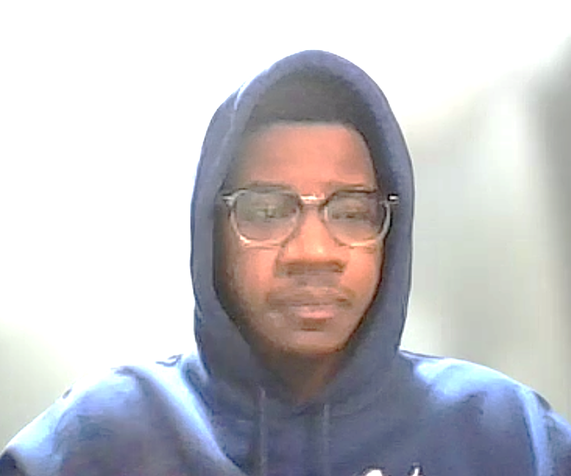
1st Place
Ahmed Ibrahim
Nigerian Muslims Association of Dallas
Winning Prize: $1,000

